Slide 1
romance
Lindsay Walker

Slide 2
How Do I love Thee?
Elizabeth Barrett Browning ( pg 111)
How do I love thee? Let me count the ways.
I love thee to the depth and breadth and height
My soul can reach, when feeling out of sight
For the ends of being and ideal grace.
I love thee to the level of every day’s
Most quiet need, by sun and candle-light.
I love thee freely, as men strive for right.
I love thee purely, as they turn from praise.
I love thee with the passion put to use
In my old grief's, and with my childhood’s faith.
I love thee with a love I seemed to lose
With my lost saints. I love thee with the breath,
Smiles, tears, of all my life; and, if God choose,
I shall but love thee better after death.

Slide 3

What is Romantic to different ages?

Slide 4
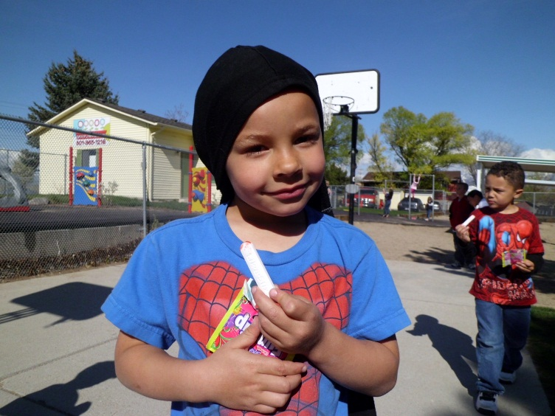
When my mommy takes care of me when I am sick…….
JORDAN, age 4, MALE

Slide 5
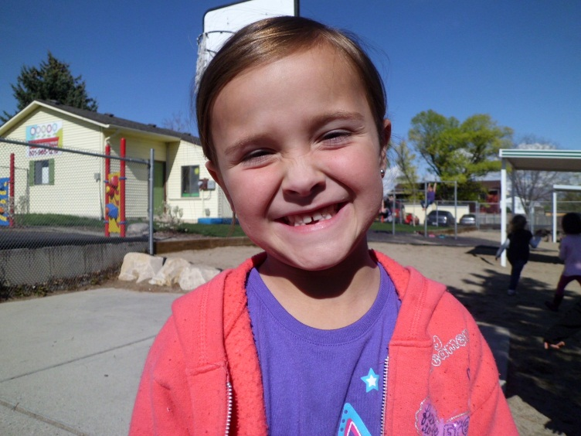
When my mom takes me for a ride in her new car…..
ZOEY, age 5, FEMALE

Slide 6
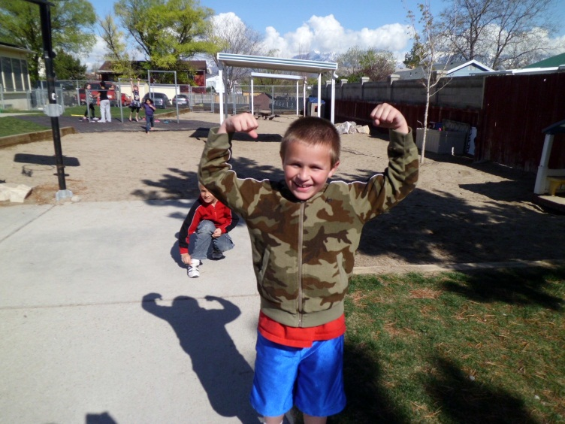
When I go to a neat place to eat dinner with my dad…..
COLBIE, age 5, MALE

Slide 7
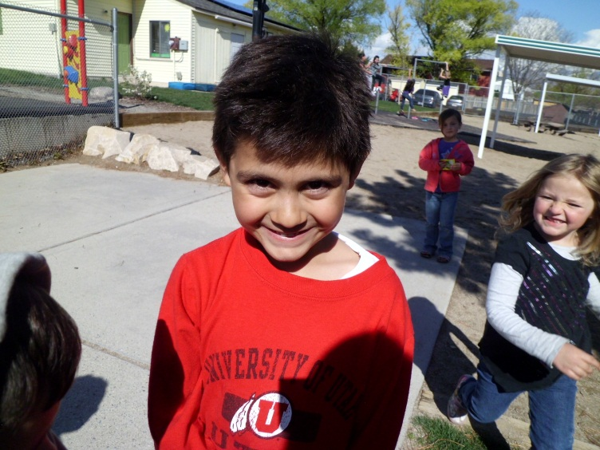
When your five going on six it could mean
Playing basketball with my dad when he has time…..
JUAQUINE, age 6, MALE

Slide 8
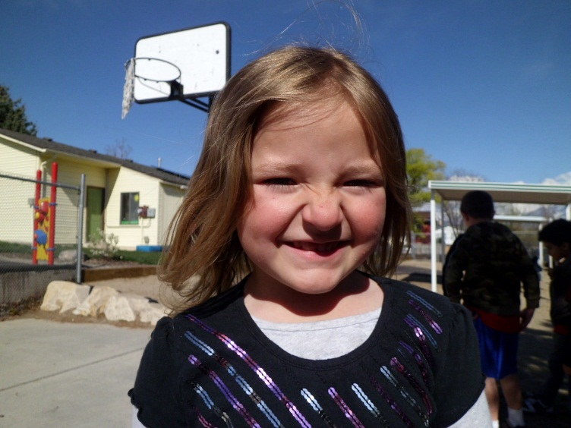
On November 7, My mom and dad gave me a cake for my birthday…..
KAITLYN, age 6, FEMALE

Slide 9
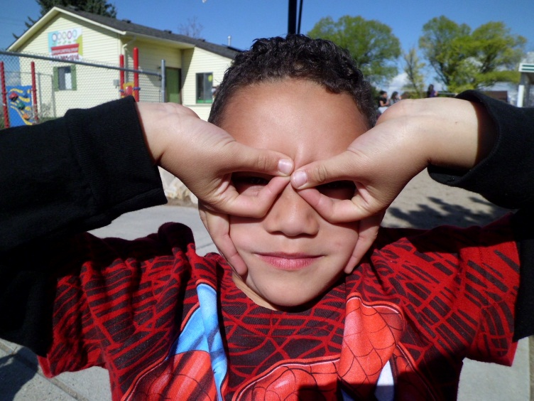
Having quiet time all to myself….
ISLEY, age 6, MALE

Slide 10
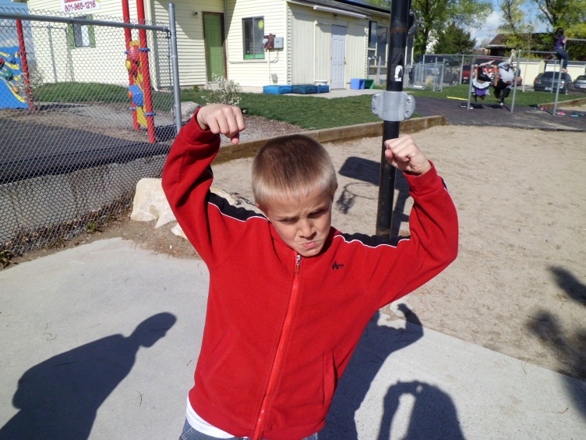
HAVING A FAMILY PARTY!!!!!
COLBIE, age 7, MALE

Slide 11
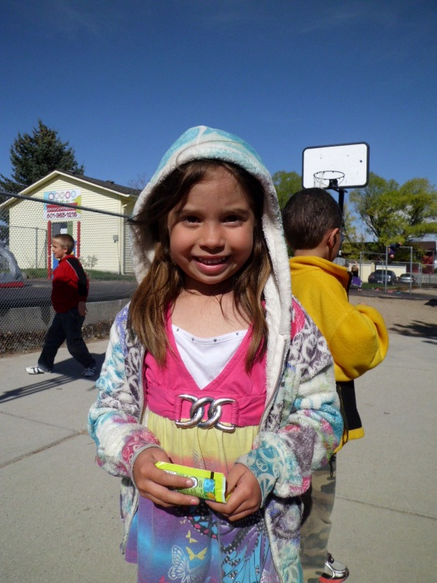
I don’t know what that means…..
DEJA, age 5, FEMALE

Slide 12
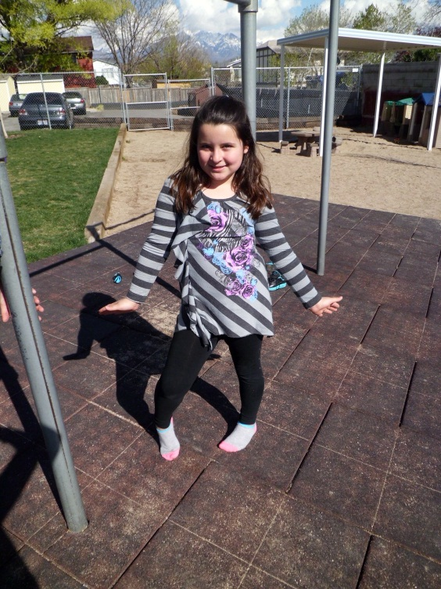
Romance at age eight is…
My valentines dance at school!!!
NINA, age 8, FEMALE

Slide 13
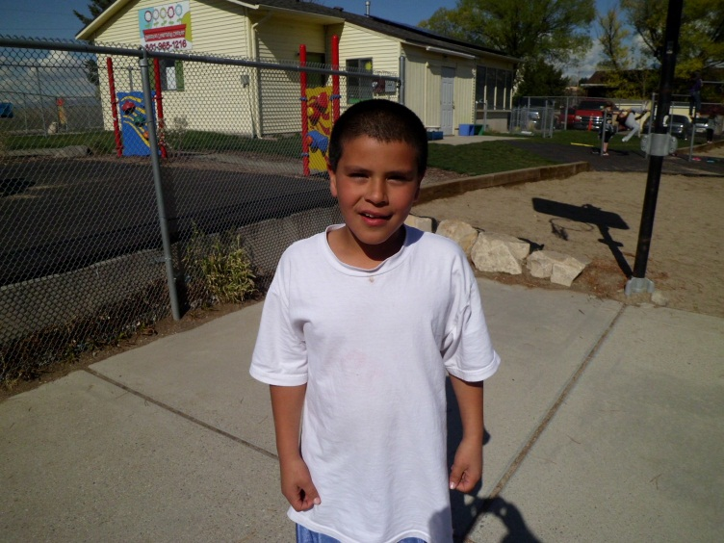
When a girl I tapped on the shoulder turned around and I gave her a kiss on the lips…..
AROHN, age 8, MALE

Slide 14
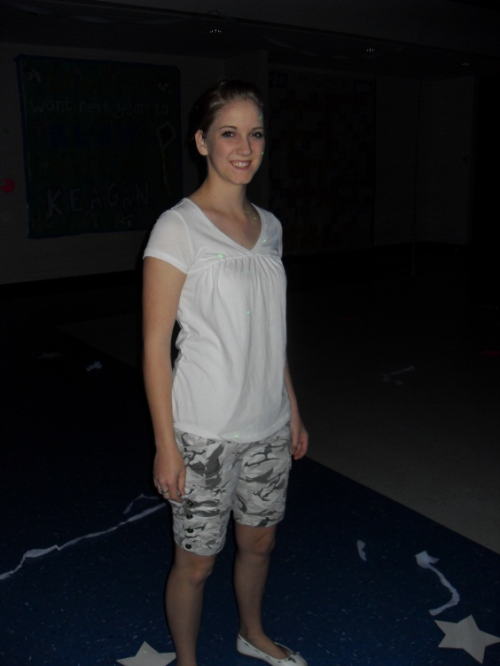
Romance to a sixteen year old
When A boy that I really liked brought me home from a party and walked me to my door and gave me the biggest hug good night. I am not into the kissy stuff….
BRITTANY, age 16, FEMALE

Slide 15
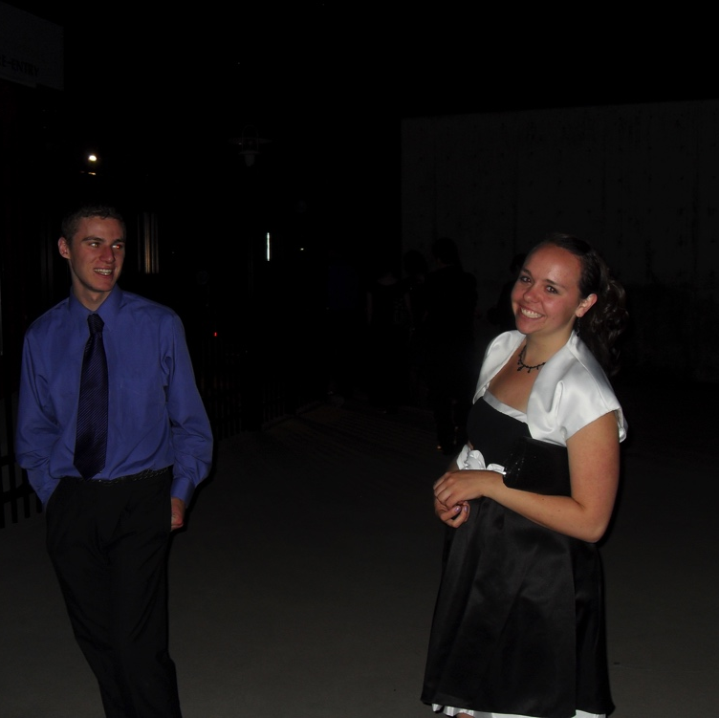
When I planned a fancy dinner for my girlfriend’s birthday. I blind folded her and she had no idea where we were going. I wore a tux and she wore her fanciest dress. It was just the two of us with our homemade food and candle light…… She loved it!
Derek, age 17, MALE

Slide 16
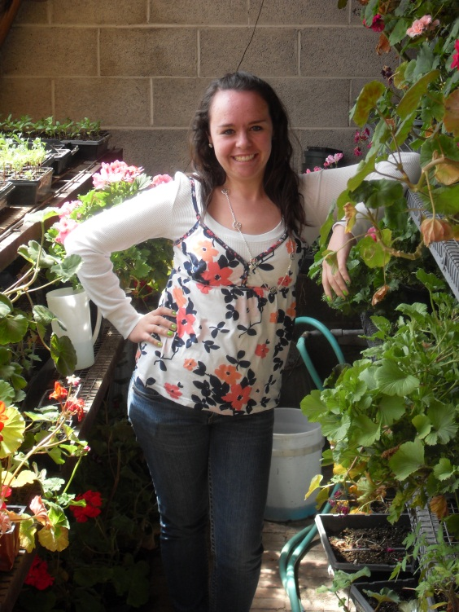
My boyfriend brought me a dozen pink roses and it wasn’t even valentines or my birthday….
KILEY, age 17, FEMALE

Slide 17
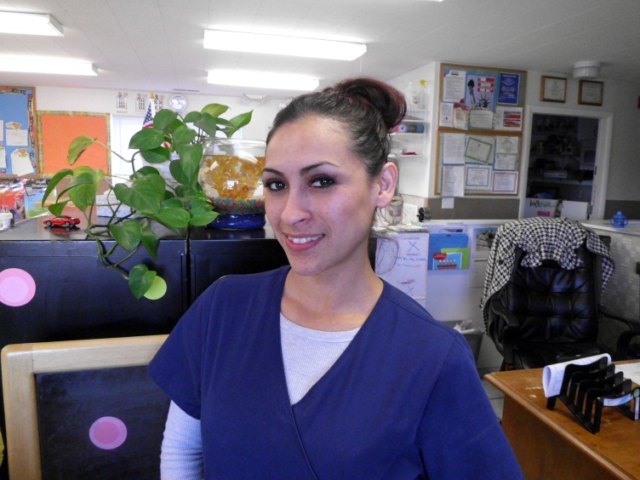
Romance for 20&up
Being taken out to a fancy, intimate, elegant restaurant with someone that I really care about. You know, like a place you feel inadequate to be in…..
JESSIE, age 24, FEMALE

Slide 18
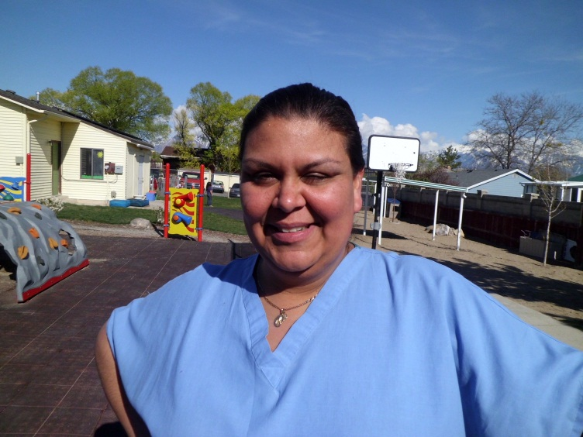
Just holding hands with my husband, having him open doors for me makes me feel very special. To me, that is what romance is all about…..
REA, 38, FEMALE

Slide 19
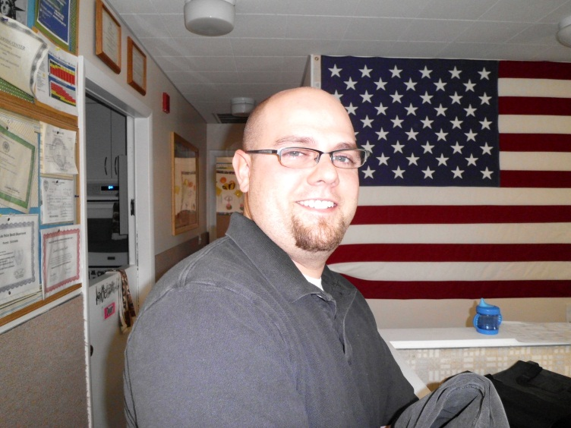
Just doing something nice for my wife. Keeping it simple, like taking a walk, talking, understanding each other. Midnight motorcycle rides when the kids are asleep is something we enjoy doing together.
TIM, age 41, MALE

Slide 20
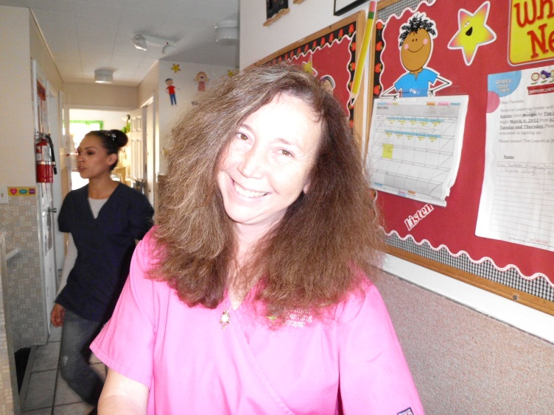
Being as old as I am, I would have to say:
Pampering
Tender moments
Candle light
Bubble baths
Snuggling
Feeling special
LINDA, age 53, FEMALE

Slide 21
SO is there a right or a wrong way to be romantic?
Ages 4-8
Ages 16 & Up
Dinner with parents
Playing sports with parents
Getting car rides with parents
Having family parties
Going to a valentines dance
Kissing someone
Fancy dinners/Dressing up
Flowers/Candles
Dancing
Activities
Holding hands
Being with a significant other

